Slide 1

From Crystal to Adsorption Column: Challenges in Multiscale Computational Screening of Materials for Adsorption Separation Processes
Data to Discovery, 2019
Lev Sarkisov
Institute for Materials and Processes, School of Engineering, The University of Edinburgh, EH9 3JL, UK
e-mail: Lev.Sarkisov@ed.ac.uk

Slide 2



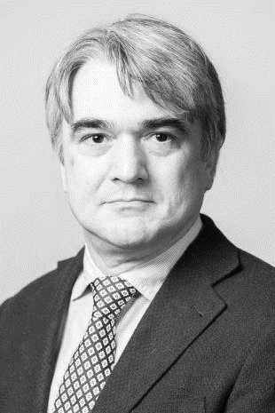
From Crystal to Adsorption Column: Challenges in Multiscale Computational Screening of Materials for Adsorption Separation Processes
Data to Discovery, 2019
Dr Amir
Farmahini
Dr Shreenath
Krishnamurthy
Dr Daniel
Friedrich
Prof. Stefano
Brandani
EPSRC: EP/N007859/1

Slide 3
Few concepts: adsorption
Adsorption occurs whenever a solid surface is exposed to
a gas or a liquid: it is defined as the enrichment of material or
increase of density of the fluid in the vicinity of an interface
(Rouquerol et al)
Adsorbent
(porous structure)
Adsorbate
Adsorbent
(‘flat’ surface)

Slide 4
Few concepts
PHYSISORPTION | CHEMISORPTION
WEAK, LONG RANGED van der Waals and electrostatic interactions | STRONG, SHORT RANGE BONDING Chemical bonding involved.
NOT SURFACE SPECIFIC Physisorption takes place between all molecules on any surface providing the temperature is low enough. | SURFACE SPECIFIC E.g. Chemisorption of hydrogen takes place on transition metals but not on gold or mercury.
ΔH_{ads} ≈ 5 - 50 kJ mol⁻¹ | ΔH_{ads} ≈ 50 - 500 kJ mol⁻¹
Non activated with equilibrium achieved relatively quickly. Increasing temperature always reduces surface coverage. | Can be activated, in which case equilibrium can be slow and increasing temperature can favour adsorption.
No surface reactions. | Surface reactions may take place:- Dissociation, reconstruction, catalysis.

Slide 5
Few concepts
Mechanisms of selectivity
* one component exhibits stronger
interaction with adsorbent and therefore
is selectively removed from the mixture
* one component is not able to fit in the pores
and therefore is excluded from adsorption
* one component exhibits higher transport diffusion
and is selectively removed from the mixture

Slide 6
Adsorption: applications
Purifications:
- Removal of organics from
vent gases
- SO₂ from vent gases
- H₂O from air, methane, N₂
- Removal of solvent, odours
from air
- NOx from N₂
- Organics from water solution
- Water from organic solution
- Decolourization
Separations:
- N₂/O₂
- Acetone from vent stream
- C₂H₄ from vent
- Normal paraffins/ Iso praffins
- CO, CH₄, CO₂, N₂, Ar from
hydrogen
- Normal paraffins from Iso paraffins
- Normal paraffins from olefins
gas phase
liquid phase

Slide 7
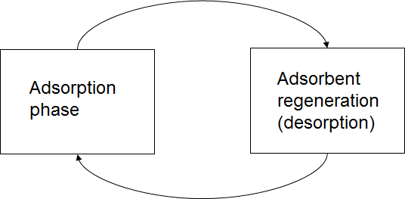
Adsorption: processes
Δn
Δn
n_{i}
P1
P2
P
Adsorption isotherms

Slide 8
Adsorption: processes

Slide 9
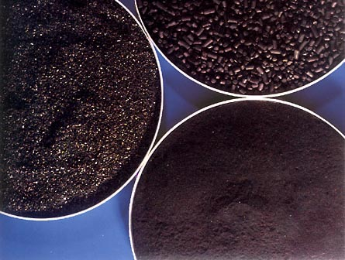
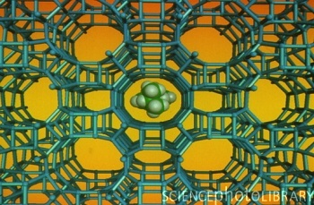
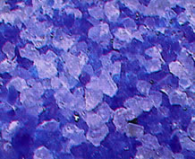
Adsorption processes: materials
Approximate worldwide annual sales of major materials
Activated carbon ~$400M
Zeolites ~$120M
Silica ~$32M
Activated alumina ~$30M

Slide 10
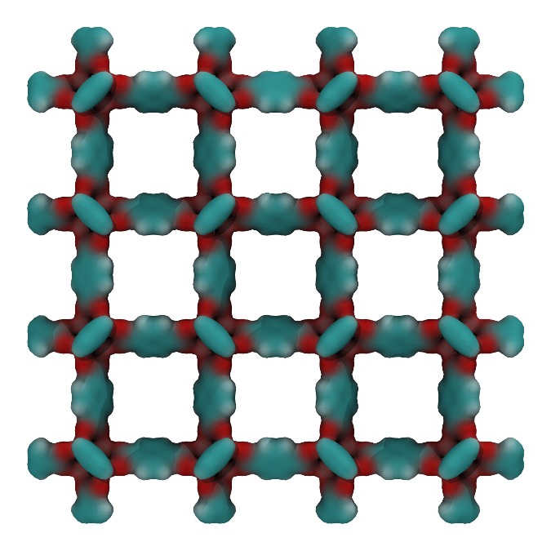
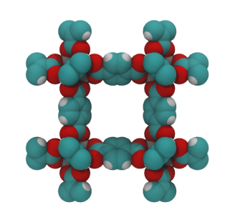
Adsorption processes: new materials
Metal-Organic Frameworks
Crystalline
Low density/high surface area
Properties depend on building blocks
+
=
Zn₄O complex
O
O
C
=
O
C
O
IRMOF-1

Slide 11
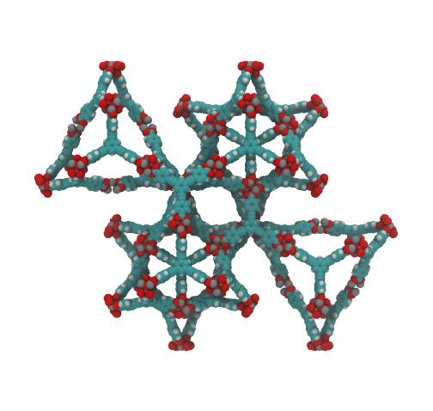
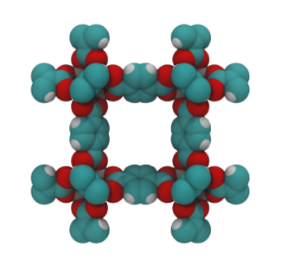
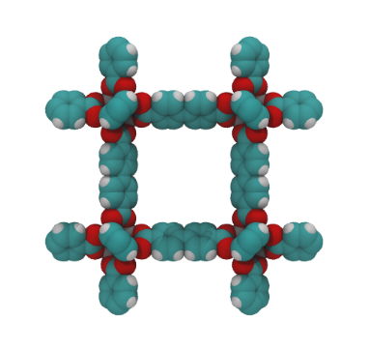
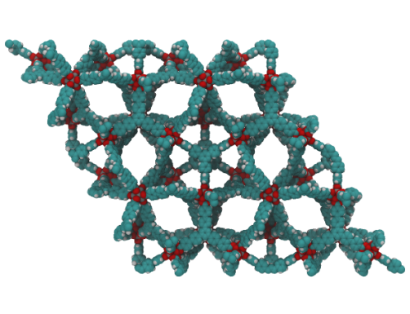
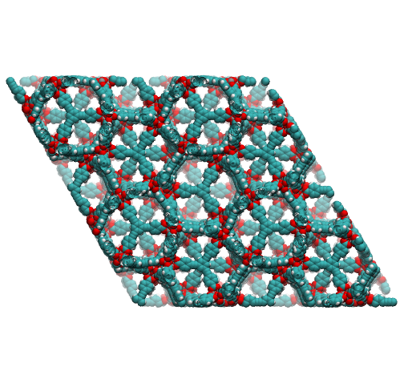
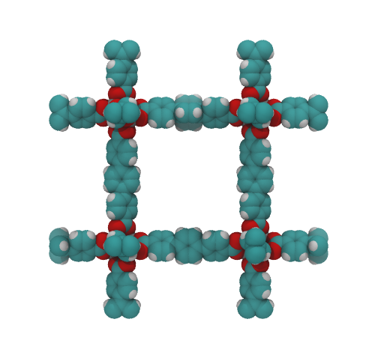
Adsorption processes: new materials
Metal-Organic Frameworks
IRMOF-1
MOF-180
IRMOF-10
MOF-200
IRMOF-16
MOF-210
Eddaoudi et al, Science, 2002
Furukawa et al, Science, 2010

Slide 12
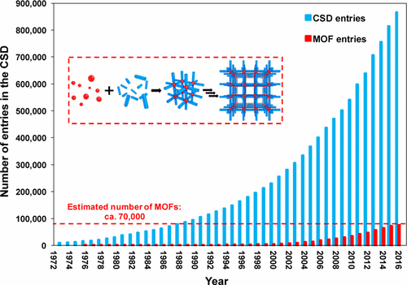
Emerging classes of materials for adsorption applications
Chem. Mater. 2017, 29, 2618−2625

Slide 13
Emerging classes of materials for adsorption applications
Opportunities:
- Unique, optimal material for a specific application
Challenges:
- How to select and test a material from an (essentially)
infinite set of synthesized and hypothetical structures?
+ Experimental effort is prohibitive

Slide 14
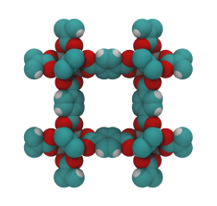
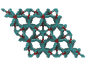


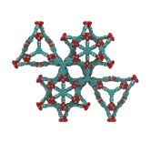

Computational screening
Search for new candidate
no
One material
Experimental systems and processes
Performance targets met
yes
Many materials
Most promising
candidates
Performance targets met
Experimental systems and processes
Computational
screening

Slide 15
Computational screening: concepts
How can we implement this computational screening?
Can we identify the best material for a particular application
using some correlations between structural characteristics
and adsorption properties?

Slide 16
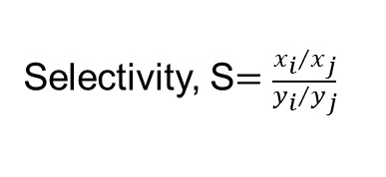
Computational screening: concepts
Structural characteristics
Surface area
Pore volume
Largest pore size
Pore limiting
diameter
Adsorptive (functional) characteristics
q
q
q
K_{H}
ΔN
P
P
P
Henry’s constant, K_{H}
Working capacity, ΔN

Slide 17
Computational screening: concepts
Desired adsorptive
(functional) characteristics
Structural characteristics

Slide 18
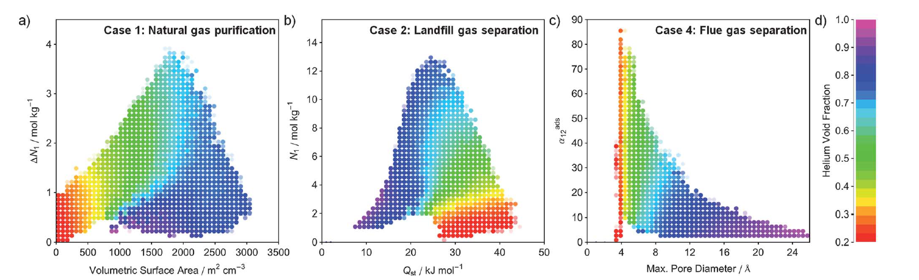
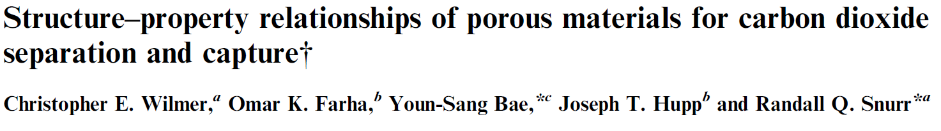
Computational screening
Early efforts focused on specific characteristics of materials, such as working capacity. These characteristics can be obtained from molecular simulations alone.
Energy Environ. Sci., 2012, 5, 9849

Slide 19
Computational screening: towards real processes
Many materials
Computational
screening
Most promising
candidates
Performance targets met
Experimental systems and processes
Real processes can be very different from the lab scale
experiments
Isolated functional metrics may not reflect the
performance of the material in the actual process
Depends on the application

Slide 20
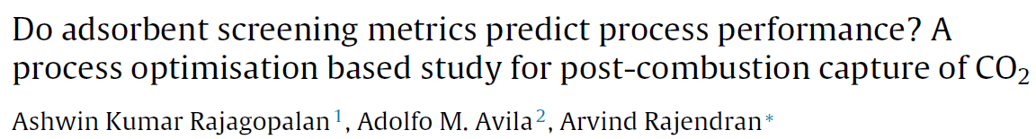
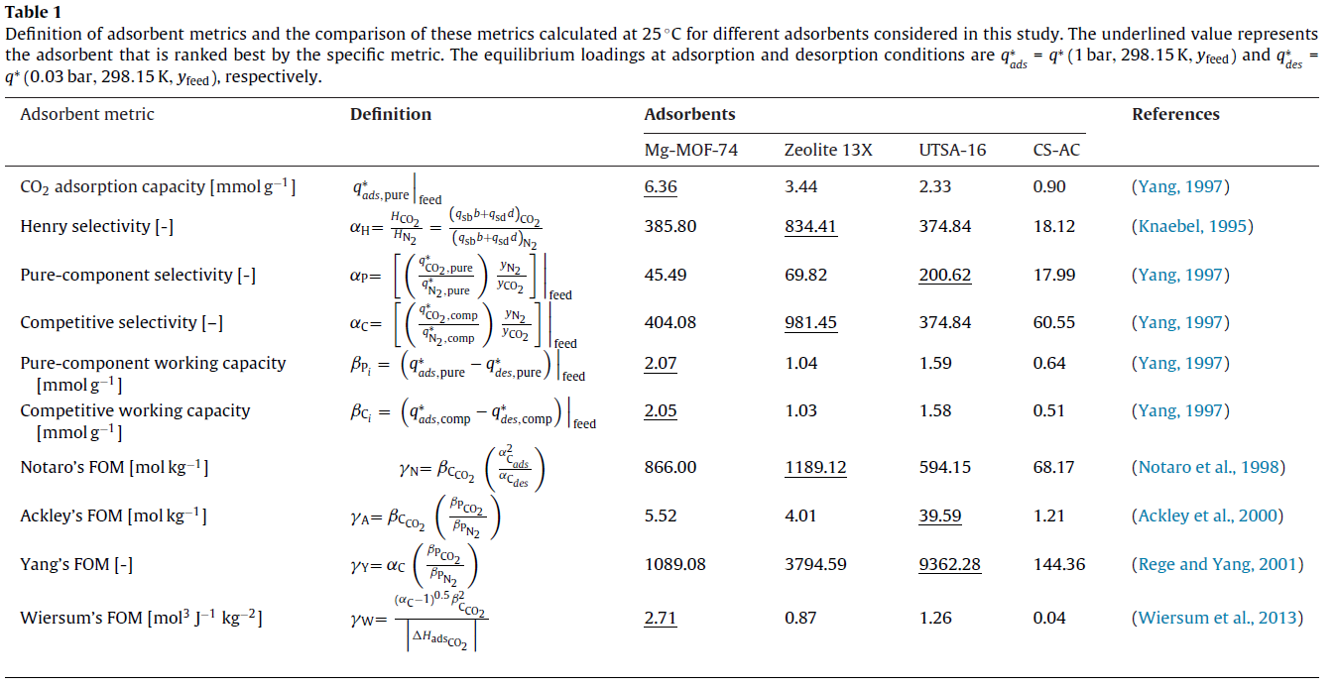
Computational screening: carbon capture
Carbon capture: ranking of materials is not possible on a single/simple adsorption characteristic

Slide 21
Computational screening: concepts
Can we identify the best material for a particular application
using some correlations between structural characteristics
and adsorption properties?
We need to explore performance of the material in
the actual process

Slide 22
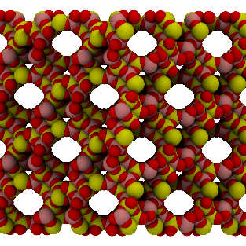
Multiscale simulation strategies
The idea: combine molecular and process simulations into a single multiscale strategy
GCMC
VSA/PSA
Equilibrium data is obtained from molecular simulation and
fed into process simulations. The PSA/VSA process is then optimized for each specific material.
Thus, we obtain the best performance of the material that can be obtained within a specific PSA/VSA process

Slide 23
Case study: CO₂/N₂ in 13X
Post-combustion: feed is 85% N₂ 15 CO₂ at 1 bar, 298K
Objective: 95% purity at 90% recovery of CO₂ at minimum energy penalty and maximum productivity
Step 1. Equilibrium data from molecular simulations
Step 2. Construction of the VSA process model
Step 3. Process simulation and optimization
Challenges at each step

Slide 24
Step 1: equilibrium adsorption data
Challenges:
+ Force fields, particularly for nitrogen
+ Accuracy of the prediction for binary mixtures

Slide 25
Step 1: equilibrium adsorption data
CO₂
The amount of binder is used
as optimization parameter to match experimental data at
298.15K at high loadings
Still agreement is not great,
particularly for nitrogen
FF: Vujic and Lyubartsev Modelling Simul.
Mater. Sci. Eng. 24 (2016) 045002
N₂

Slide 26
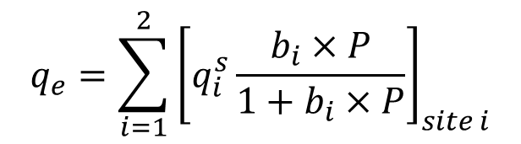
Step 1: equilibrium adsorption data
Process simulation needs an analytical equation to describe adsorption equilibria.
Seems simple, but not trivial:
+ Dual Site Langmuir isotherm
+ Predictions are sensitive to how these models are constructed
$$q_{e}=\sum_{i=1}^{2}{{\left[q_{i}^{s}\frac{b_{i}×P}{1+b_{i}×P}\right]}_{site i}}$$

Slide 27
Dual Site Langmuir model
CO₂
N₂
Fit to single component isotherms at different temperatures

Slide 28
Dual Site Langmuir model: predictions for binary mixture
CO₂
N₂

Slide 29
Dual Site Langmuir model: predictions for binary mixture
Selectivity at 283.15K; FIT 1: - - -; FIT 2

Slide 30
Step 2: construction of the process model
Challenges:
+ A significant number of parameters
+ Not all parameters can be provided by
molecular simulations

Slide 31
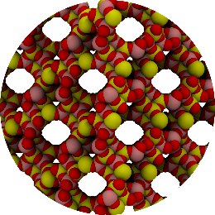
Step 2: construction of the process model
Review of process modelling of a PSA cycle: what information is needed?
Column
Pellet
Crystal
Crystallites and binder
Macropores
R_{p}
r_{p}
ε, ε_{p}
ρ_{cr}, V_{micro}
PSA model: a system of differential equations describing mass and energy balance in the column, with appropriate boundary conditions

Slide 32
Step 2: construction of the process mode
Column
Pellet
Crystal
Crystallites and binder
Macropores
R_{p}
r_{p}
ε, ε_{p}
ρ_{cr}, V_{micro}

Slide 33
Step 2: construction of the process model
Review of process modelling of a PSA cycle: what information is needed?
Column
Pellet
Crystal
Crystallites and binder
Macropores
R_{p}
r_{p}
ε, ε_{p}
ρ_{cr}, V_{micro}
PSA model: a system of differential equations describing mass and energy balance in the column, with appropriate boundary conditions
Simplifications: no micropore resistance, linear driving force macropore diffusion

Slide 34
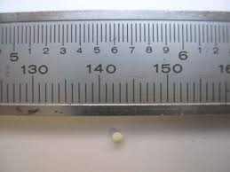
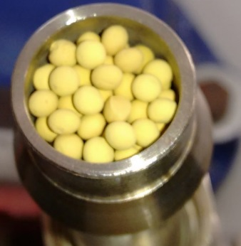
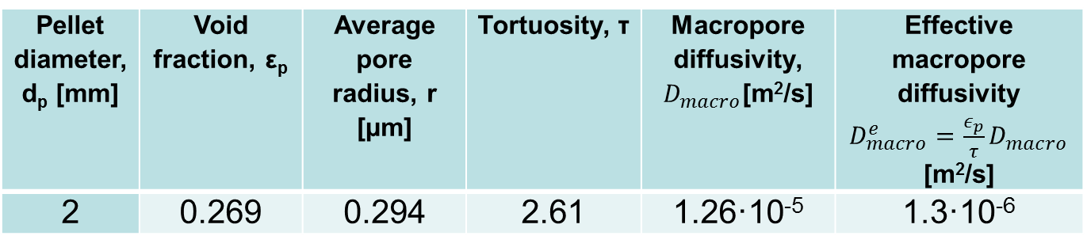
Step 2: properties of the pellet
Contains 15-20% binder
Pellet diameter, d_{p} [mm] | Void fraction, ε_{p} | Average pore radius, r [µm] | Tortuosity, τ | Macropore diffusivity, $D_{macro}$[m²/s] | Effective macropore diffusivity $D_{macro}^{e}=\frac{ε_{p}}{τ}D_{macro}$ [m²/s]
2 | 0.269 | 0.294 | 2.61 | 1.26·10⁻⁵ | 1.3·10⁻⁶
Hu et al., Adsorption (2014) 20:121–135

Slide 35
Step 3: process optimization
N₂
4-step process with light product pressurization
CO₂/N₂
P
adsorption
blowdown
evacuation
repressurization
time

Slide 36
Step 3: process optimization
N₂
4-step process with light product pressurization
CO₂/N₂
P
adsorption
blowdown
evacuation
repressurization
time

Slide 37
Step 3: process optimization
N₂
Decision variables: evacuation and blowdown pressures, time of steps
Constraints: 95% CO₂ purity; 90% CO₂ recovery
CO₂/N₂
P
adsorption
blowdown
evacuation
repressurization
time

Slide 38
Step 3: process optimization
Decision variables: evacuation and blowdown pressures, time of steps
Constraints: 95% CO₂ purity, P; 90% CO₂ recovery, R
P
95%
{t_{ads}, t_{bd}…}
90%
R
So, which configuration is the best one?
Two additional characteristics:
Productivity: how much CO₂ is captured per unit of time per volume of
adsorption bed, Pr
Energy penalty: energy cost per mol of CO₂ captured, E

Slide 39
Step 3: process optimization
Decision variables: evacuation and blowdown pressures, time of steps
Constraints: 95% CO₂ purity, P; 90% CO₂ recovery, R
P
95%
{t_{ads}, t_{bd}…}
90%
R
E
Pr

Slide 40
Step 3: process optimization
Decision variables: evacuation and blowdown pressures, time of steps
Constraints: 95% CO₂ purity, P; 90% CO₂ recovery, R
P
95%
{t_{ads}, t_{bd}…}
90%
R
E
Pareto front: best
productivity at lowest energy
Pr

Slide 41
Step 3: process optimization
Decision variables: evacuation and blowdown pressures, time of steps
Constraints: 95% CO₂ purity, P; 90% CO₂ recovery, R
P
95%
{t_{ads}, t_{bd}…}
90%
R
E
Comparison of materials
in terms of Pareto fronts
Genetic algorithms are
used to locate these fronts
Pr

Slide 42
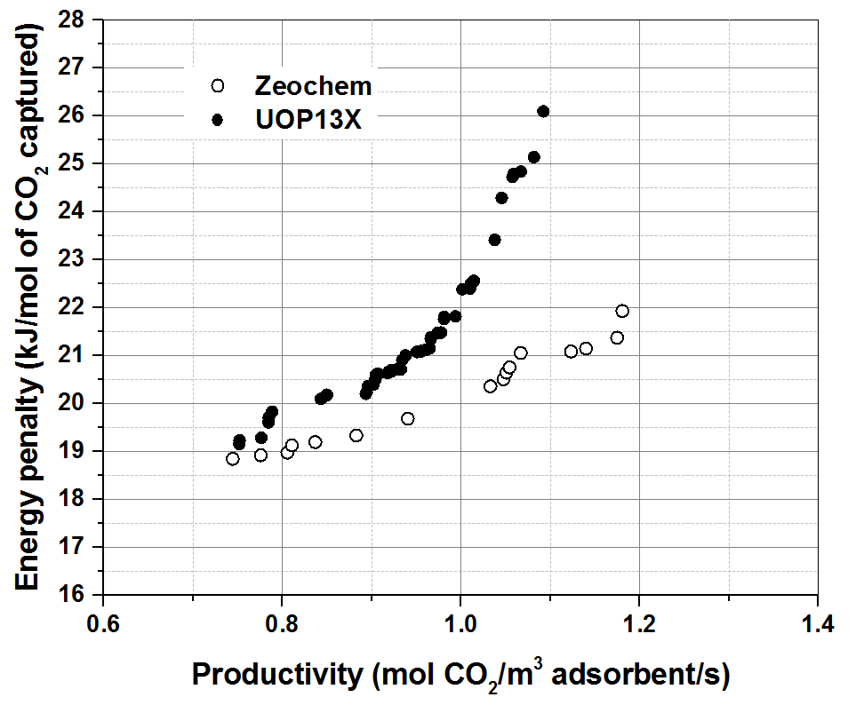
Case study: CO₂/N₂ in 13X
Nalaparaju et al., Chemical Engineering Science 2015, 124, 70-78.

Slide 43
Challenges
Data organization and databases
Large number of new porous materials
Materials designed on a computer
Requires systematic organization of the materials according to some principles
Is all the data needed for molecular simulations provided in the databases?

Slide 44
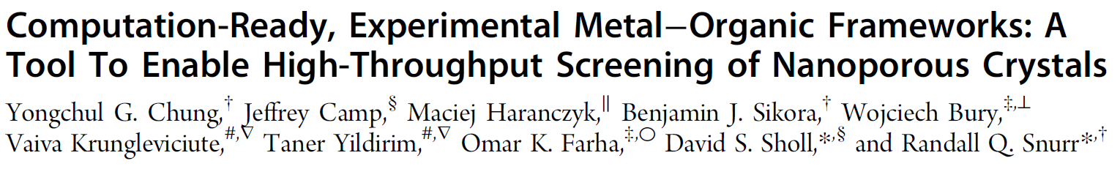
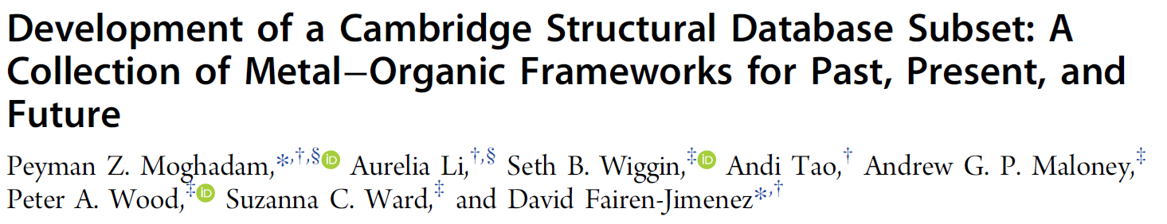
Challenges
Data organization and databases
Chem. Mater. 2014, 26, 6185−6192
Chem. Mater. 2017, 29, 2618−2625

Slide 45
Challenges
Data reproducibility
What should be reported? (parameters, CPU details)
How? (SI, GitHub)
Can I reproduce a published result given the information provided?
Can I reproduce a result from my own group once the PhD/Posdoc left
Unfortunately, the answer is quite often: no
Enormous resources (time, effort) are spent on attempts to reproduce published results

Slide 46
Challenges
Data reproducibility
Objective challenges for reproducibility of experiments
Is it the same problem for simulations?

Slide 47
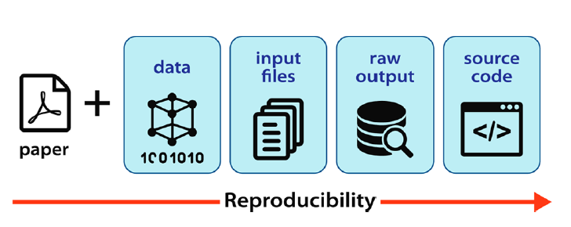
Challenges
Data reproducibility
F.X. Coudert
Chem. Mater. 2017, 29, 2615−2617

Slide 48
Challenges
Data reproducibility

Slide 49

Challenges
Data reproducibility
RASPA
Sarkisov
29/10/2018
Parameter set
#331235
download

Slide 50
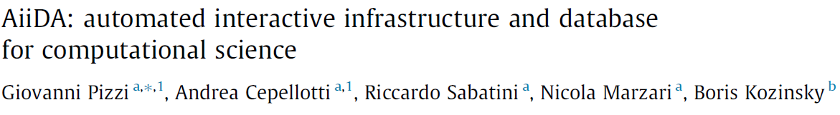
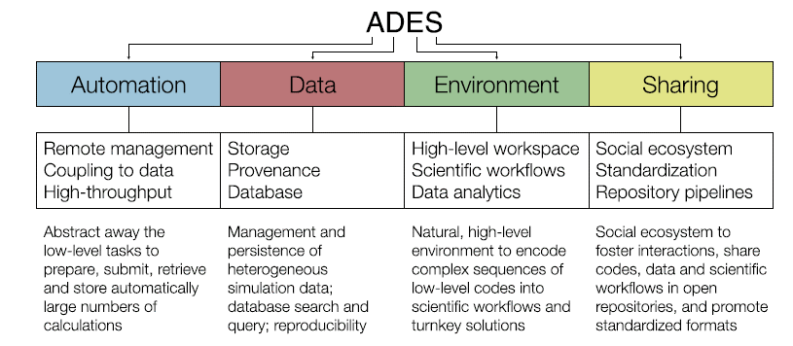
Challenges
Data reproducibility
Computational Materials Science 111 (2016) 218–230

Slide 51

Summary
• Performance of the materials in the actual process depends on the pellet size, porosity and other parameters
• These parameters are not available from molecular simulations
• Become optimization parameters
• Ability to accurately rank materials in the processes also depends on the accuracy of the adsorption isotherms from molecular simulations
• Current focus in force field development is on carbon dioxide, but the performance crucially depends on the accuracy of nitrogen adsorption as well
• “From Crystal to Adsorption Column: Challenges in Multiscale Computational
Screening of Materials for Adsorption Separation Processes” Farmahini et al.,
Ind. Eng. Chem. Res., DOI: 10.1021/acs.iecr.8b03065
EP/N007859/1
ECDF

